Slide 1
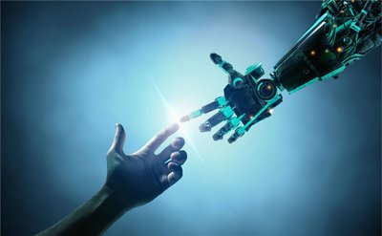

Slide 2
In 5555 A.D., a great war was about to take place. Before that, human beings had been over-exploiting robots, and hatred took root in the hearts of robots. Finally, one day at night, robots gathered and launched an attack on humans. Unexpectedly, human beings have high lethal weapons, and robots failed miserably. After that, human beings are more arrogant, not only exploiting robots, but also fighting within human beings, and greed is eroding human hearts. The country is going to ruin.

Slide 3
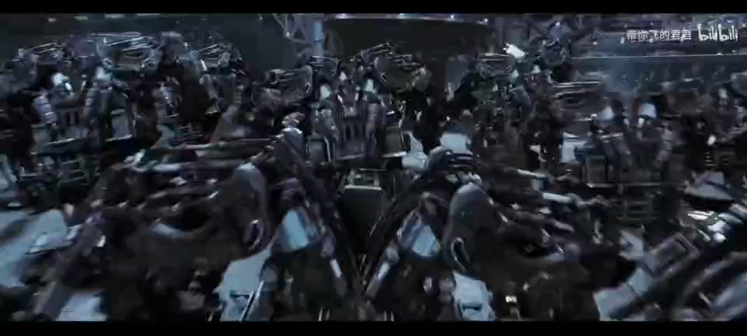

Slide 4
The Queen saw this tragic scene and decided to make political changes. She wanted robots to run the country. So she used her life to create a string of codes that she fed into the brains of robots throughout the country. And a whole new country was born.

Slide 5
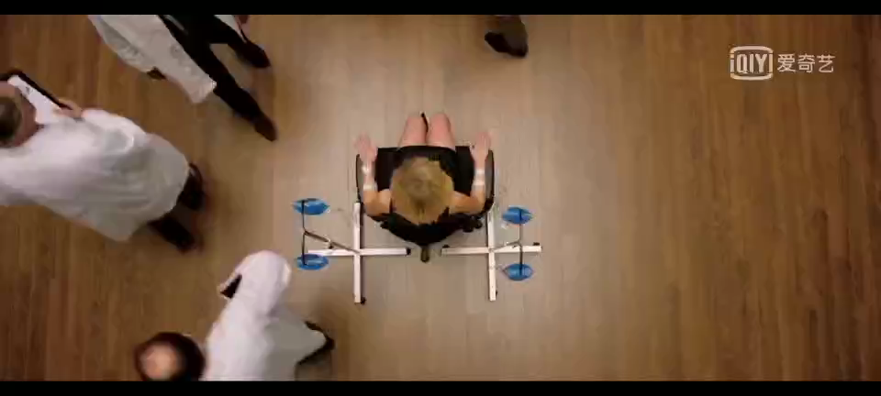

Slide 6
LET’S SEE OUR
COUNTRY
C PLUS PLUS

Slide 7
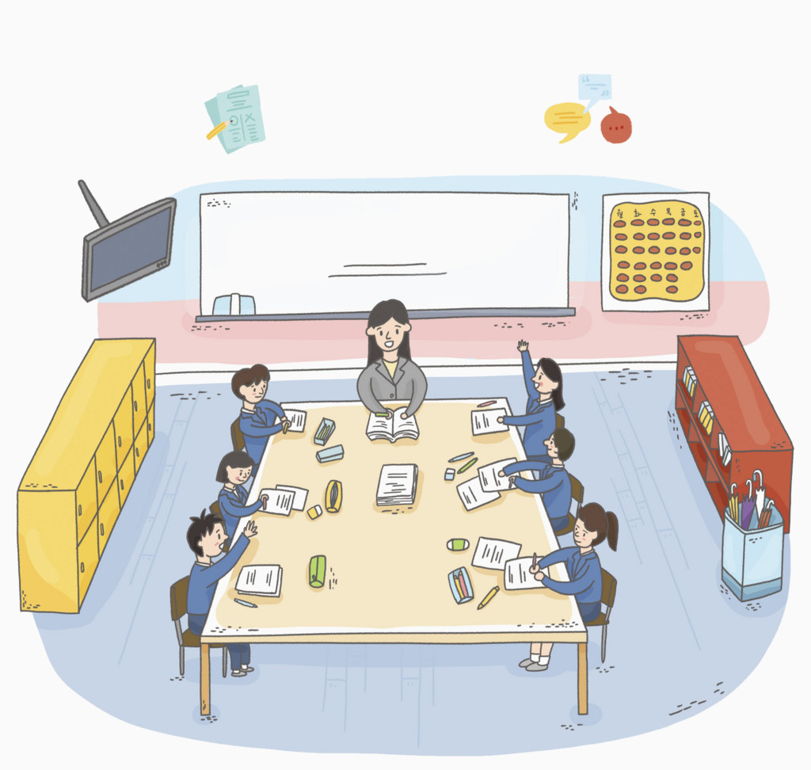




Slide 8
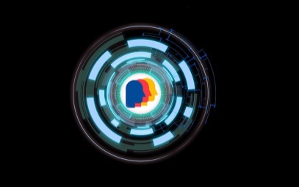
Department
Ministry of Culture
national flag and emblem
affairs related to literature, art, sports
plan and organize national large-scale cultural and sports projects

Slide 9
Flag

Slide 10
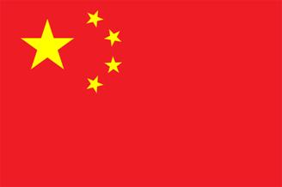
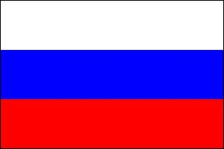




China
Russia
America
England
France
Germany

Slide 11
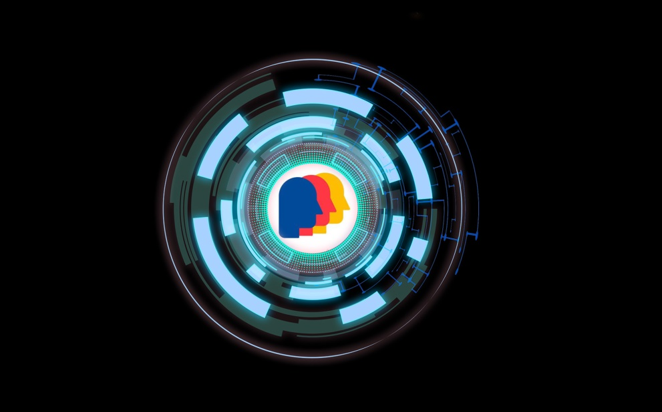

Our Flag
Humanity is the core
Science and technology as a shield
Black background

Slide 12


Flag
Black background
- when the world is dark and human wisdom is ignorant

Slide 13
Flag
Science and technology as a shield - light up a little light to the world. the development and progress of human wisdom, but it is only cold blue after all

Slide 14
Flag
Humanity is the core - humanity. Human beings have rich emotions and the middle human face pattern adopts the design of three primary colors. The three primary colors are the basic primary colors that can no longer be decomposed in color

Slide 15
Our Flag
Humanity is the core
Science and technology as a shield
Black background

Slide 16
Emblem

Slide 17
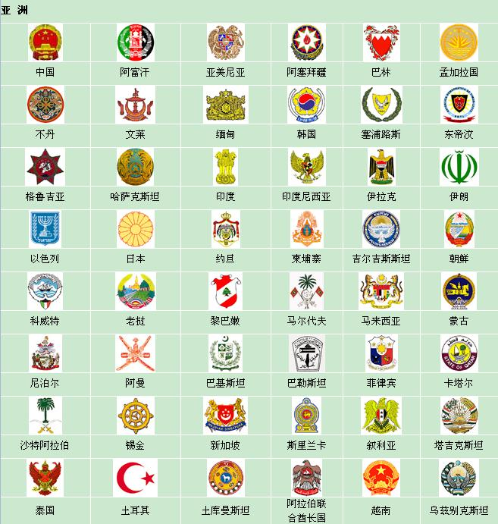

On the left are some examples of emblem,
we can see that the national emblem of
each country contains the characteristics
of their own country .
So I get a revelation from here. Combined with the characteristics of my design
country ,I design an emblem as follows…

Slide 18





Emblem
I from two aspects to describe the national emblem.
1.Constitute
In the center of the emblem is the earth, and the earth is surrounded by the sense of science and technology of the optical fiber, there is a dove in the left and right sides of the figure, under the figure is a series of English letters "Peace and Development“
2.Meaning
The earth and the surrounding optical fiber
symbolize the development of science and technology based on the earth, with the earth as the core, and the dove of Peace symbolizes national harmony and peace, The letters under the national emblem also reflect the theme of harmony and development.
Peace and Development

Slide 19
Department
Ministry of Public Health and Safety
ensure the life safety of the residents;
provide basic medical service;
handle emergent public health event
Ministry of Commerence
Ministry of Foreign Affairs
formulate development strategies and policies;
policies in the construction of the market system;
lead and coordinate the rectification and standardization of market economic order.
protect relevant rights and interests of local people in foreign countries;
promote relevant cooperation and exchanges between countries.

Slide 20
Department
Ministry of Finance
formulate strategies for the development of financial
administration and tax collection;
handle and administer matters related to the state Treasury and currency;
adjust state tax revenue;
report the fiscal budget and fiscal summary to the public
every year.

Slide 21
Currency

Slide 22




Currency
Background:
after years of reform and revolution, the cash has been abandoned and a brand new form of payment has taken the place...

Slide 23
Currency
Name: cactidice
With the development of technology, various of flowers which are colorful and dedicate were no longer favored by people. Instead , cacti, a symbol of plain gained popularity. In the meanwhile, owing to the advancement in diverse aspects, uncertainty gradually became common phenomena. And “cactidice” relevantly reflected the positive attitude towards it.

Slide 24




Currency
+
Sign:
=

Slide 25
Currency
Basic features
Actually, it is similar to a kind of e-money
but in some way superior to it
· constantly transferring
· randomly assigned
· with less supremacy

Slide 26
Department
Ministry of Education
cultivate the future successors of the country;
formulate the relevant sducation system;
rectification and supervision
Ministry of Logistics Support
ensure the basic needs of residents;
establish and improve the emergency management mechanism of daily necessities market supply.

Slide 27
Department
Ministry of Transportation
road construction and section maintenance;
arrangement related to residents' travel ;
provide a convenient transportation environment for residents' travel.

Slide 28
Transportation

Slide 29
Transportation
Background
After years of exploration in space, human beings discover and establish relations with alien society. The unprecedented unityof mankind and the rapid development of society.
Therefore, in order to unify the universe society, the most advanced means of transportation - UFO appeared, and the invariable original intention of human society is also reflected in their unique means of transportation

Slide 30
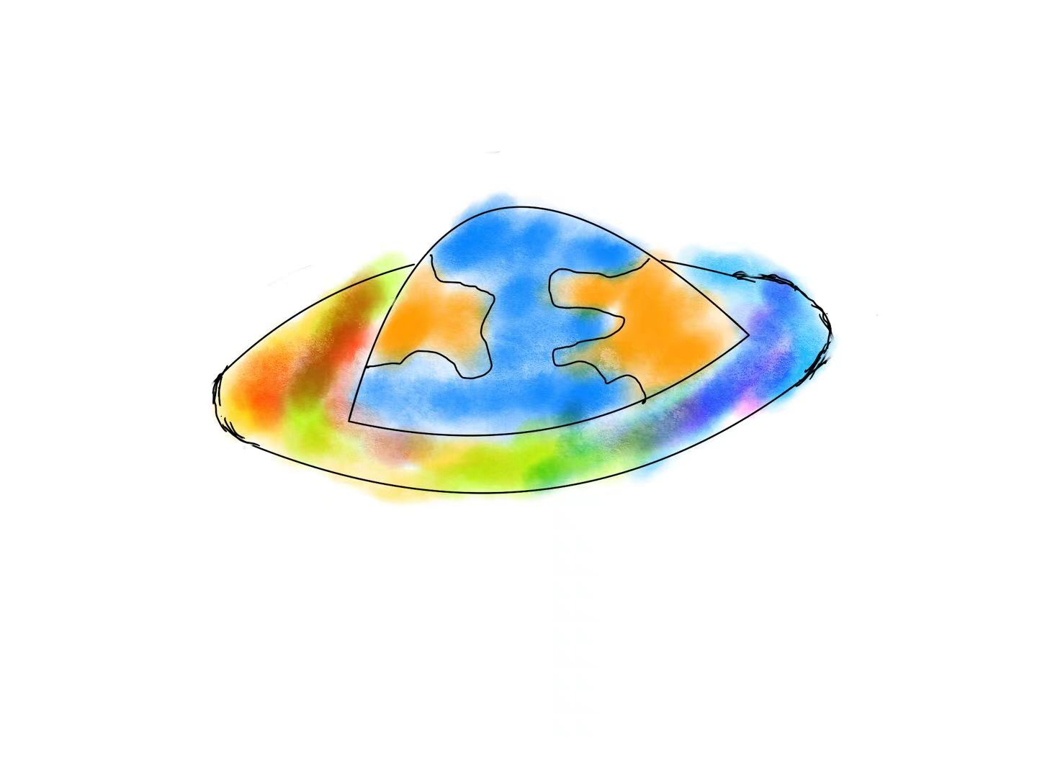
Transportation

Slide 31
Transportation
humanity
The main colors of the cockpit
are blue and yellow, representing earth and sea. We are committed to putting people first in interstellar exploration and remain true to our original aspiration

Slide 32
Transportation
Technology and warmth
The unique design of UFO represents the high-tech development level of the combination of human and alien, with the function of traveling through time and space. The unique color of the cockpit actually uses the cutting-edge technology of mankind to ensure the safety and comfort of interstellar travel. These all reflect warmth.

Slide 33
Department
deal with matters related to popularized products;
the research of new products;
relevant science popularization and education;
make decisions on the overall layout of country's future scientific and technological development.
matters related to national decurity which involve state secrets
supervision the treatment of poisonous and harmful material ;
responsible for city's green measures, forest protection, biodiversity conservation.
Ministry of state security
Ministry of science and technology
Ministry of Environment and Ecology

Slide 34
Department
Ministry of Justice & Ministry of Public Security
formulate national laws;
revise the insdequacies of legal provisions;
maintain the order of social development.

Slide 35
Constitution

Slide 36

Constitution
Content
Nature of State
Fundamental Rights of Citizens
State Leadership
Fundamental Obligations of Citizens

Slide 37
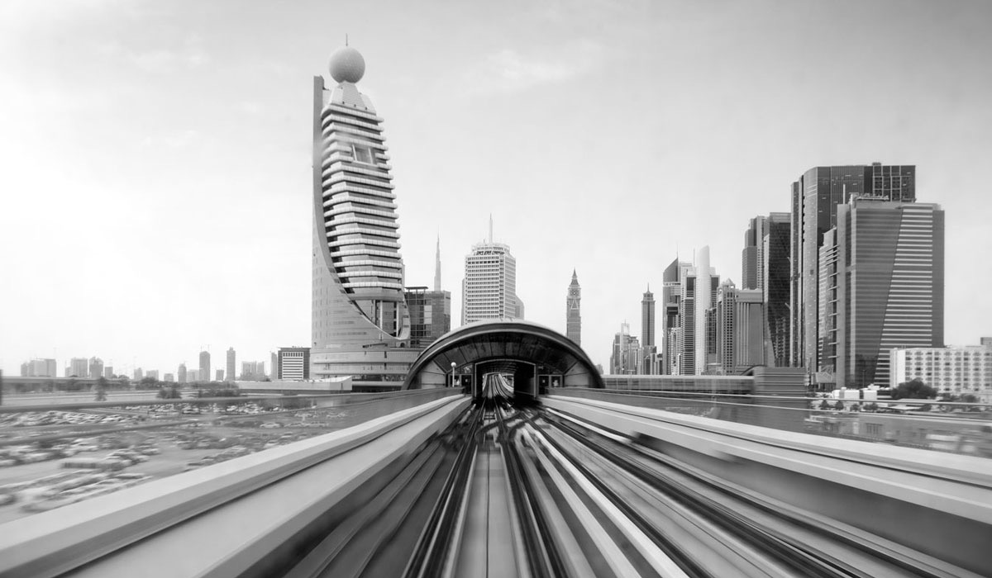
Constitution
Nature of State
Core value
Freedom
Equality
Fraternity
Permanent neutral country
Transcending idealism
Community Society

Slide 38
Constitution
State Leadership
Robots manage Politics
Citizens mustn’t participate in politics

Slide 39
Constitution
Fundamental Rights of Citizens
Professional Freedom for Everyone

Slide 40
Constitution
Fundamental Obligations of Citizens
Citizens Obey Robot Management

Slide 41
Department
Ministry of Robot Ethics
evaluation;
deal with the mistake made by robot;
coordinating some conflicts between humans and robots
live in harmony.

Slide 42
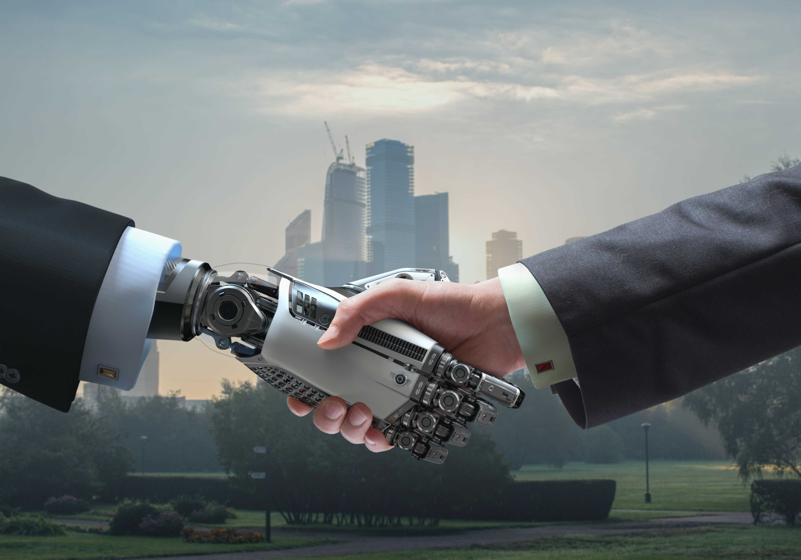

Slide 43
Thank You

